Slide 1
Agents for Conversational Geodata Search
Faculty of Environmental Sciences
Chair of Geoinformatics
AGILE 2025 Tutorial, Dresden, Germany
Simeon Wetzel, Auriol Degbelo, Stephan Mäs

Slide 2

Agenda
Key features of an Agent
Introduction to the Framework

Slide 3
Why Agents
LLMs only are not enough to solve complex problems
They are complemented with different tools
Agents
… take over the control logic within the application
… are useful to automate complex workflows (keyword: automated orchestration)

Slide 4
What is an Agent?
Notes:
Types of agents according to IBM:
https://www.ibm.com/think/topics/ai-agent-types

Slide 5
Definition of an Agent
A hardware or software-based computer system that exhibits the following characteristics:
Autonomy
Social ability
Reactivity
Proactivity
[Wooldridge and Jennings 1995]
Notes:
https://doi.org/10.1017/S0269888900008122

Slide 6
Features of an agent
Autonomy: agents operate without the direct intervention of humans, and have some kind of control over their actions and internal state.
Social ability: Agents interact with other agents (and possibly with humans) using some form of agent communication language.
Reactivity: Agents perceive their environment - whether it’s the physical world, a user via a graphical interface, a collection of other agents, the Internet, or a combination of these - and respond to changes.
Proactivity: Agents do not merely react; they exhibit goal-directed behavior by taking independent initiative.
[Wooldridge and Jennings 1995]
Notes:
https://doi.org/10.1017/S0269888900008122

Slide 7
Features of an agent (mentioned occasionally)…
Mobility: The ability of an agent to move within an (electronic) network.
Veracity: The assumption that an agent will not knowingly communicate false information.
Benevolence: The assumption that agents do not pursue conflicting goals and therefore always strive to do what is required of them.
Rationality: (crude) assumption that an agent will act in order to achieve its goals, an will not act in such a way as to prevent its goals being achieved - at least within the limits of its beliefs.
[Wooldridge and Jennings 1995]
Notes:
https://doi.org/10.1017/S0269888900008122

Slide 8
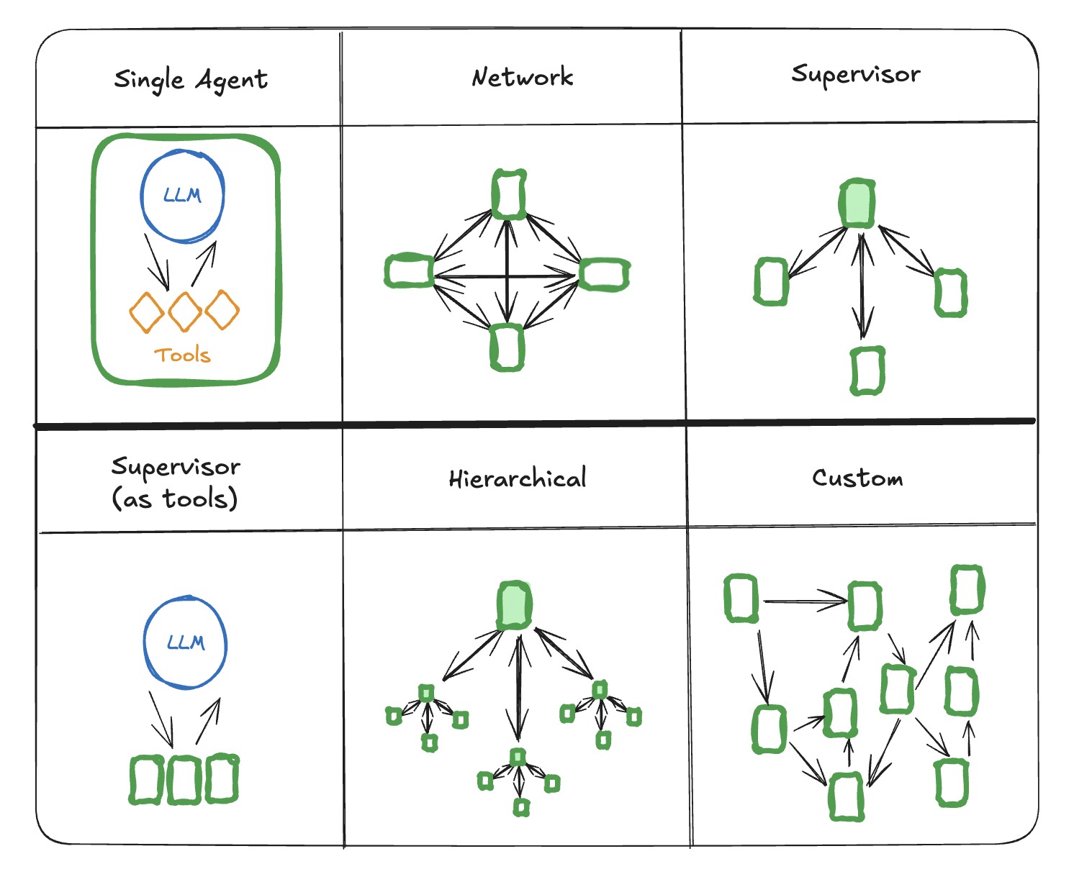
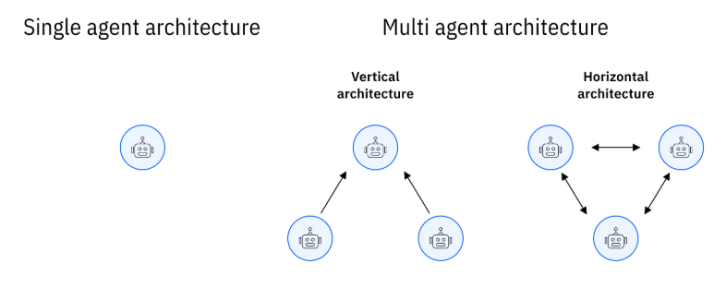
Agent-based architectures
https://www.ibm.com/think/topics/ai-agent-types
https://langchain-ai.github.io/langgraph/concepts/multi_agent/
Notes:
Supervisior agent makes decision on what agent should called next
Supervisor agents uses a tool-calling LLM to decide what agent to call next

Slide 9
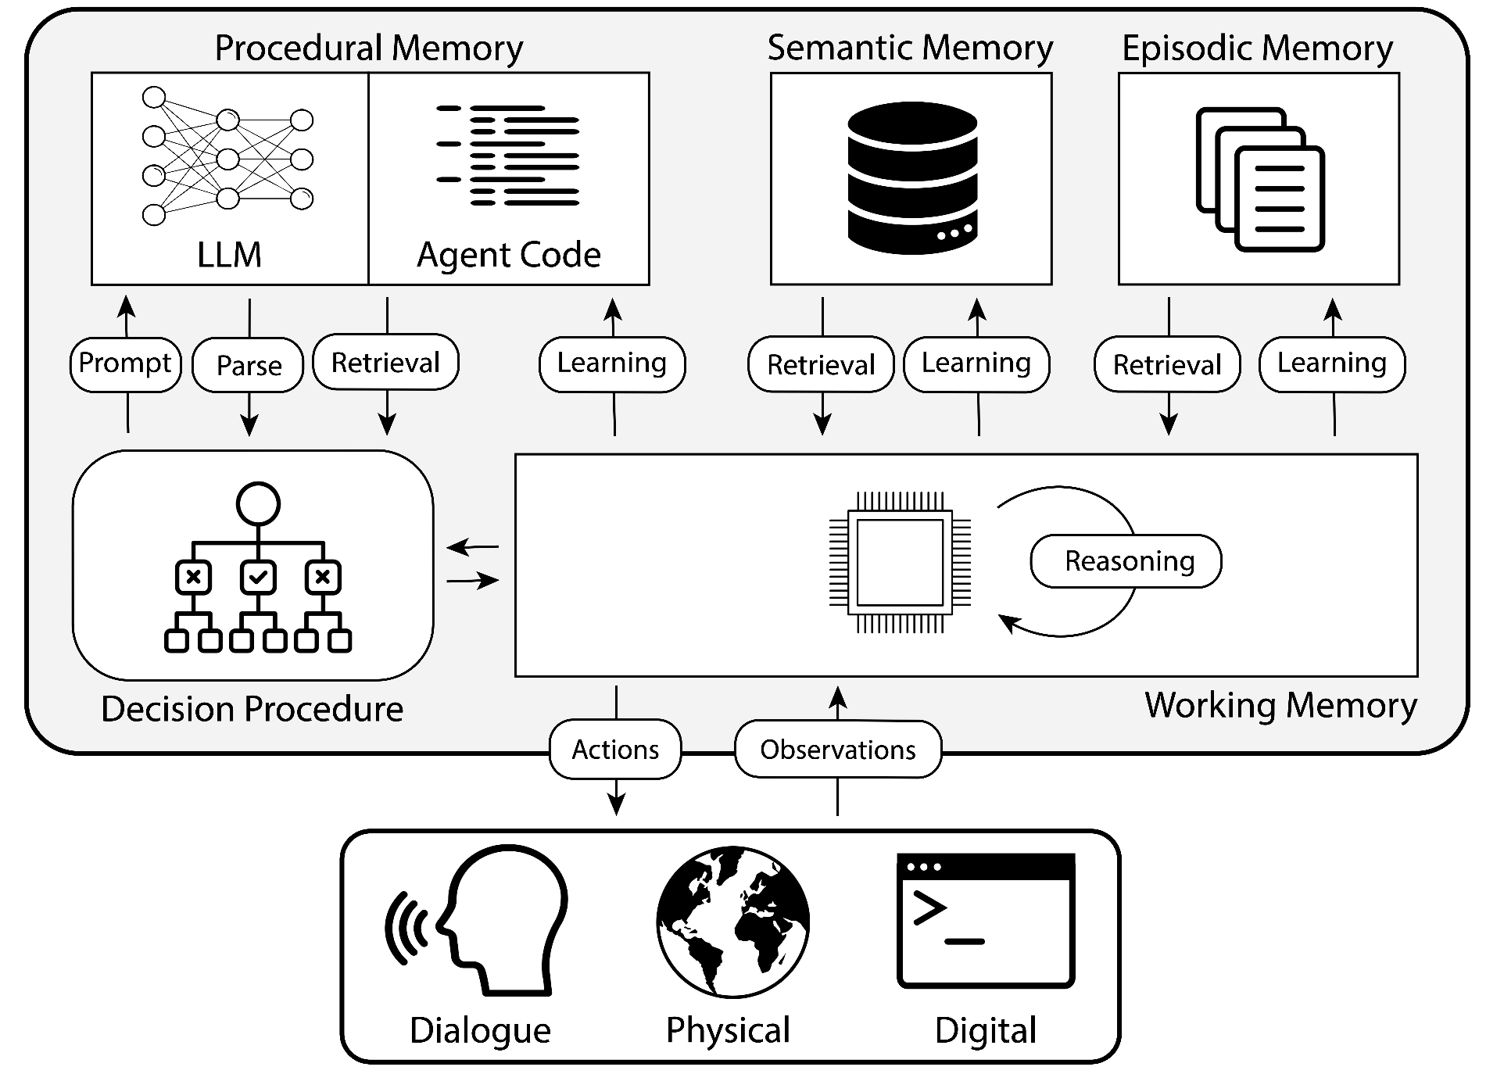
Architecture: single agent
[Summers et al 2024]
Notes:
https://github.com/ysymyth/awesome-language-agents

Slide 10
Key operations
Retrieval: read information from long-term memory into working memory.
Reasoning: process content from working memory to generate new information
Learning: write information to long-term memory (e.g. update episodic memory with experience, update semantic memory with knowledge, update LLM parameters)
[Summers et al 2024]
Notes:
https://doi.org/10.48550/arXiv.2309.02427

Slide 11
Types of memories
Short-term
Working Memory: maintains active and immediately available information for the current decision cycle, e.g. perception inputs or information from the previous decision cycle.
Episodic Memory: stores experiences from previous decision cycles, e.g. training data in the form of input-output pairs, sequences of historical events.
Semantic Memory: stores an agent’s knowledge about the world and about itself.
Procedural Memory: this has two forms: Implicit knowledge, stored in the weights of the language model; explicit knowledge, stored in the agent’s code. The agent’s code can be further subdivided into: procedures that implement actions (reasoning, retrieval, grounding, and learning) and procedures that implement decision-making.
Long-term
[Summers et al 2024]
Notes:
https://doi.org/10.48550/arXiv.2309.02427

Slide 12
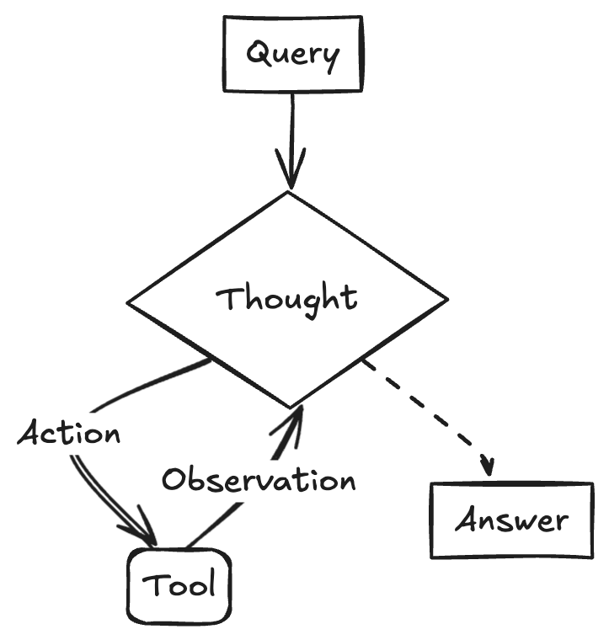
ReAct: Reasoning + Act [Yao et al 2023]
https://www.philschmid.de/langgraph-gemini-2-5-react-agent
Notes:
https://www.philschmid.de/langgraph-gemini-2-5-react-agent
https://arxiv.org/pdf/2210.03629

Slide 13
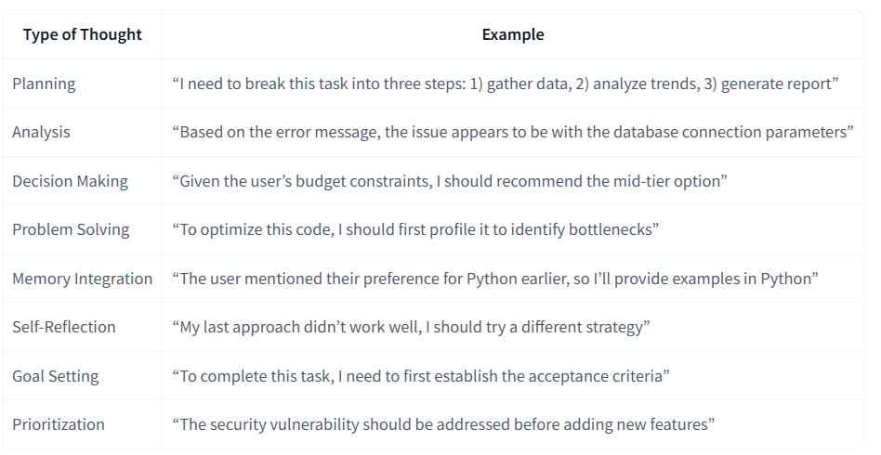
ReAct: Thought
“Thoughts represent the Agent’s internal reasoning and planning processes to solve the task”.
https://huggingface.co/learn/agents-course/unit1/thoughts
Notes:
https://www.philschmid.de/langgraph-gemini-2-5-react-agent
https://arxiv.org/pdf/2210.03629

Slide 14
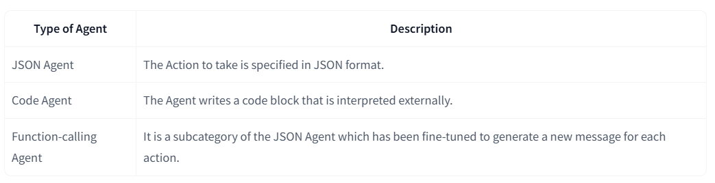
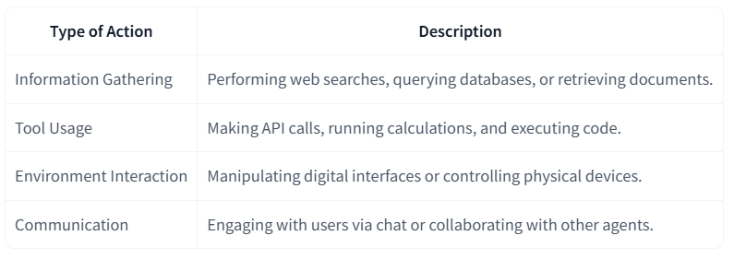
ReAct: Action
“Actions are the concrete steps an AI agent takes to interact with its environment”.
https://huggingface.co/learn/agents-course/unit1/thoughts
https://huggingface.co/learn/agents-course/unit1/actions
Notes:
https://www.philschmid.de/langgraph-gemini-2-5-react-agent
https://arxiv.org/pdf/2210.03629

Slide 15
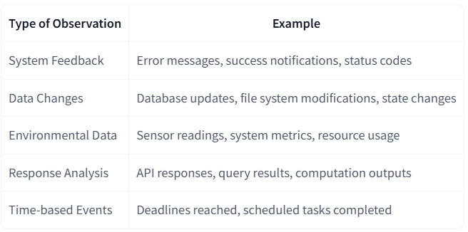
ReAct: Observation
“Observations are how an Agent perceives the consequences of its actions”.
https://huggingface.co/learn/agents-course/unit1/observations
Notes:
https://www.philschmid.de/langgraph-gemini-2-5-react-agent
https://arxiv.org/pdf/2210.03629

Slide 16
What is smolagents?

Slide 17


Smolagents
Recent framework (released 2025)
Built by HuggingFace developers
Simple python framework for building agents
Supports any LLM
from HuggingFace
or other Inference Providers (OpenAI, Groq, Anthropic, etc.)
First-class support for Code Agents

Slide 18
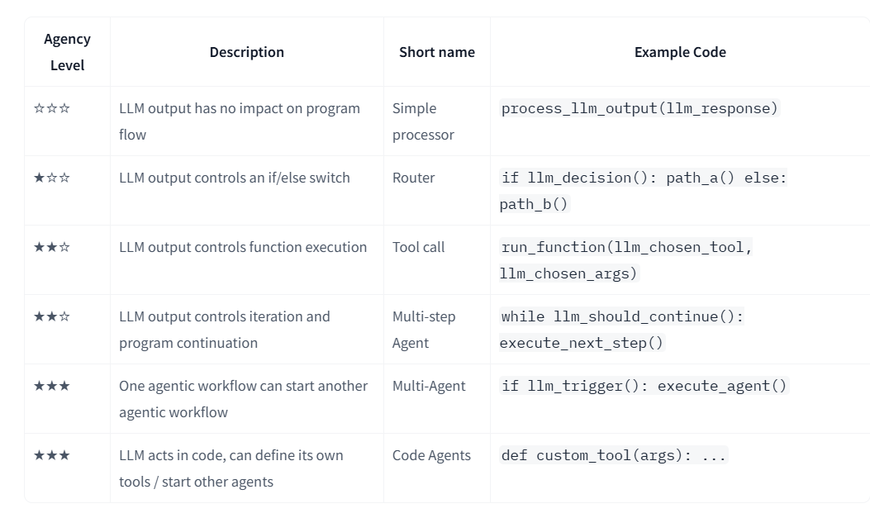
Smolagents - Different levels of agency
https://huggingface.co/docs/smolagents/conceptual_guides/intro_agents

Slide 19
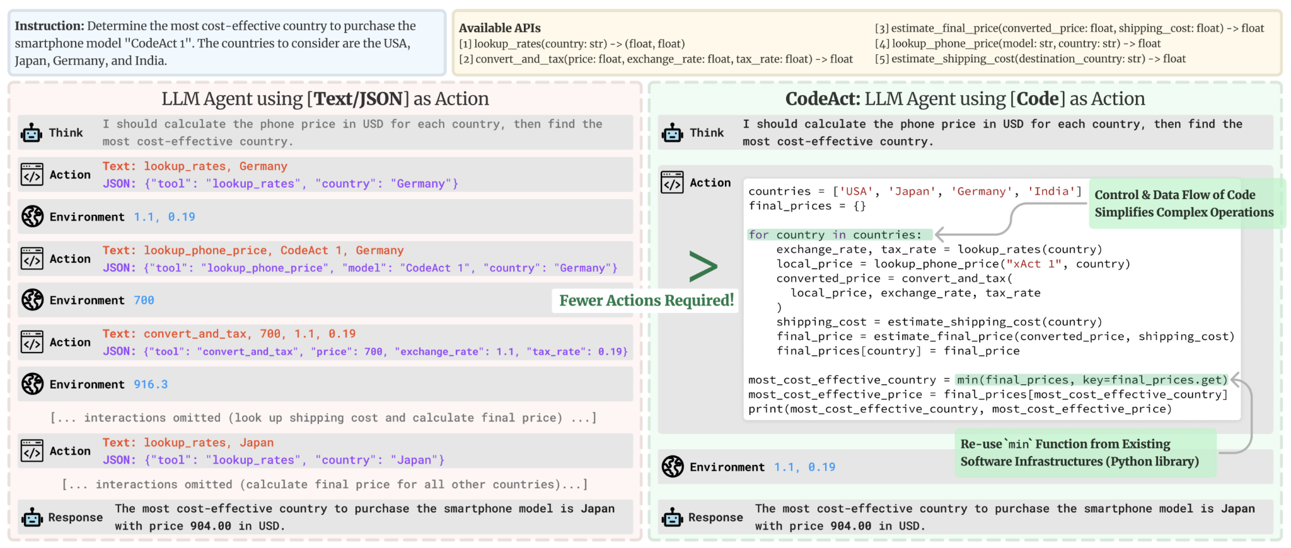
Smolagents
CodeAgents: Executable Code Actions Elicit Better LLM Agents (Wang et al. 2024, DOI)

Slide 20
Smolagents
Composability: JSON actions cannot be nested or pre-defined for later use
Object management: with JSON it is harder to store outputs of complex objects (e.g. images)
Generality: code is built to express simply anything you can have a computer do
Representation in LLM training data: plenty of quality code actions are already included in LLMs’ training data which means they’re already trained for this!

Slide 21
References
Sumers, T.R., Yao, S., Narasimhan, K. and Griffiths, T.L. (2024) ‘Cognitive architectures for language agents’, Transactions on Machine Learning Research. Available at: https://doi.org/10.48550/arXiv.2309.02427.
Wang, X., Chen, Y., Yuan, L., Zhang, Y., Li, Y., Peng, H., & Ji, H. (2024). Executable Code Actions Elicit Better LLM Agents. Proceedings of Machine Learning Research, 235(Llm), 50208–50232. Available at: https://doi.org/10.48550/arXiv.2402.01030
Wooldridge, M. and Jennings, N.R. (1995) ‘Intelligent agents: theory and practice’, The Knowledge Engineering Review, 10(2), pp. 115–152. Available at: https://doi.org/10.1017/S0269888900008122.
Yao, S., Zhao, J., Yu, D., Du, N., Shafran, I., Narasimhan, K.R. and Cao, Y. (2023) ‘ReAct: Synergizing reasoning and acting in language models’, in The Eleventh International Conference on Learning Representations (ICLR 2023). Kigali, Rwanda.

